Slide 1
Evolution
Evolution lesson is for self study. The presentation includes some information which is not in the syllabus. You will follow your text book, when you will study for exam.
What is evolution?
It is a slow and continuous process whereby complex forms of life have emerged from simpler forms through millions of years.
Jean Baptiste de Lamarck and Charles Darwin were two scientists who proposed their views on evolution which are accepted as theories of evolution.

Slide 2
Until the 1800s
People thought the same types of organisms on earth were always in existence.
This changed when scientists found fossils of organisms which are now no longer on the earth.
Scientists observed…
Fossil evidences.
Many different species exist of same genus.
Variations (differences) within species are observed.

Slide 3
Change in Thought occurred when…..
Scientists began to wonder how and why these changes took place
2 biologists believed organisms changed in response to their environments:
French Jean Baptiste Lamarck
British Charles Darwin
Lamarck’s Theory
1809 – Lamarck proposed his theory of evolution
Theory is based on 2 hypotheses
1. Organisms develop traits by the use and disuse of body parts.
2. Inheritance of acquired characteristics passed from parents to offspring.

Slide 4
Lamarck’s giraffe example
Lamarck assumed giraffes had short necks originally and ate grass
Grass died due to climate change
Giraffes ate leaves off trees
As giraffes stretched necks, necks grew
Giraffe’s acquired long necks – passed to future generations

Slide 5
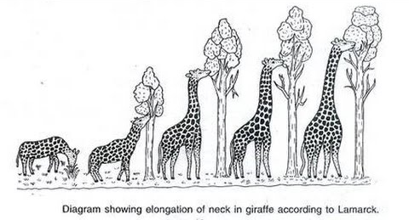
The evolution of giraffe

Slide 6
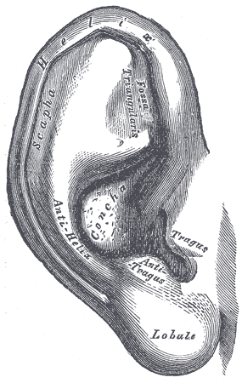
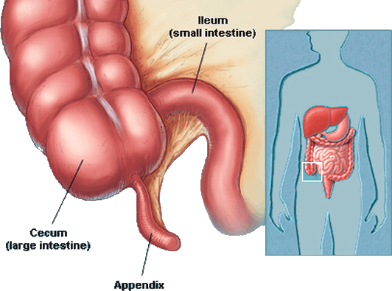
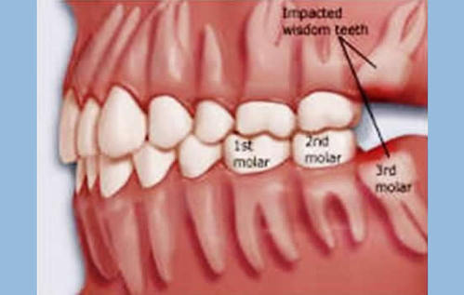
Vestigial Organs
These are the organs which have ceased to be of any use to the possessor but still
persists generation after generation. They are functionless and become atrophied(reduce in size or become rudimentary) also lose effectiveness.
In human beings there are over hundred vestigial organs, some are given below.

Slide 7
Darwin’s Theory
Published book: On the Origin of Species by Means of Natural Selection with help from another scientist, Alfred Russel Wallace
Theory based on 4 main ideas:
Variations
Inheritance of traits
Overproduction
Survival of the fittest
Explained on the following slides……….
Why was Darwin’s work controversial?
Creationism – belief that God created all living things to be unique
Evolution – theory that organisms have changed over time.

Slide 8
Variations
Variations (differences) occur among members of the same species
Ex: different breeds of dogs, horses, cats, etc.
Inheritance of Traits
Traits ( slight changes in the characters)are inherited which are suitable for survival of the organisms.
They continue to appear generations after generations.

Slide 9
Overproduction
Organisms produce more organisms than can survive and reproduce
This ensures that some offspring will survive to reproduce
Ex: fish, insects, frogs, etc.
Survival of the Fittest
Organisms with traits that are better for adapting survive to reproduce
Pass on these useful traits
Natural selection – environment determines which variations will be selected

Slide 10
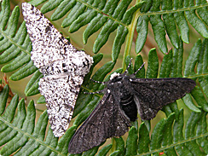
Peppered Moth Example
Early 1800s, England, Manchester
Peppered moths were mostly light gray; few were white, few were black (variations)
Gray blended with tree trunks – birds didn’t see or eat them, so they survived, but black ones were eaten
After industrial revolution pollution resulted in the death of lichens and darkening of tree trunks, now the darker variety was better hidden and not picked up by the birds. Natural selection played its role and light coloured moths easily became prey. Now , dark coloured variety survived better. This is industrial melanism.
The scientific name of this moth is Biston bitularia

Slide 11
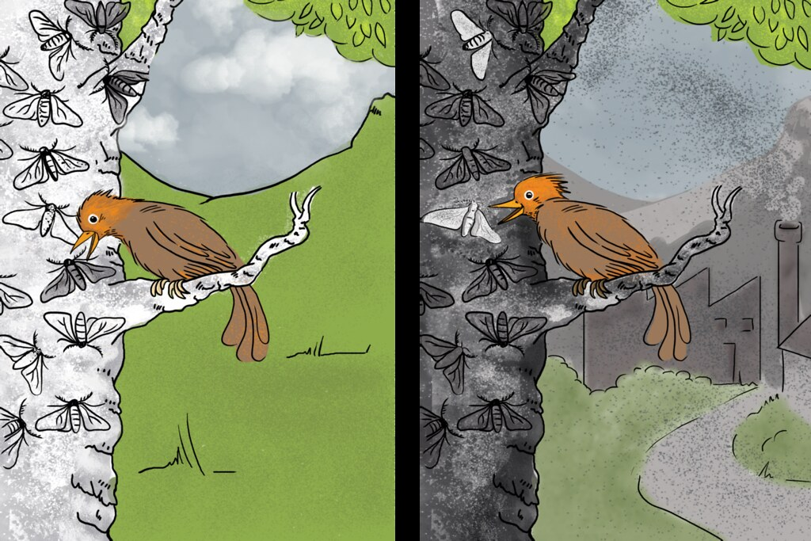
Industrial Melanism
Moth with black coloured wings was visible to birds before industrial revolution and after industrial revolution moth with light coloured wings was visible.

Slide 12
Evidence of Evolution
Fossils
Anatomy
Embryos
Molecules
Biogeography
Explained on the following slides…..

Slide 13
Fossil Evidence
Show extinct species
Show relationships between current and ancient organisms
Show intermediate species – those in between ancient and modern species
Difference in traits – derived vs. ancestral

Slide 14
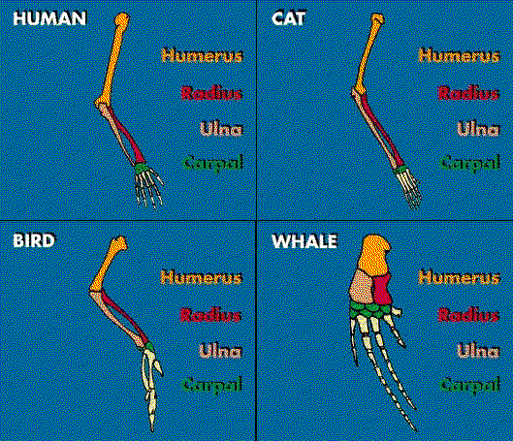
Anatomy-Homologous Structures

Slide 15
Homologous vs. Analogous
Remember, homologous – similar STRUCTURE
Analogous – structures with similar FUNCTIONS, but different structures/origins
Ex: bat’s wing and bird’s wing - analogous

Slide 16
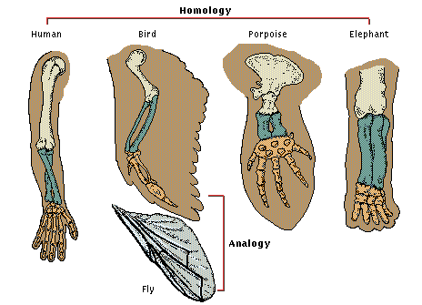

Slide 17
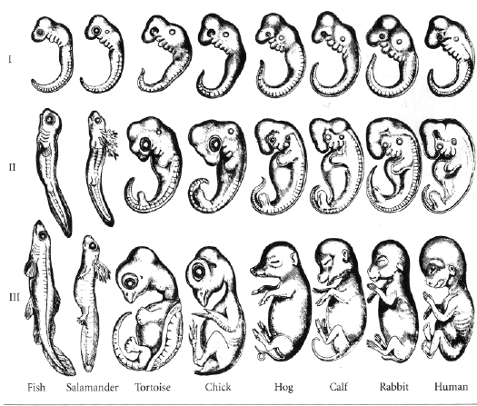
Evidence from embryonic development
In the initial stages all embryos look similar, as the development takes place as per the genetic code they start developing the characters of that individual species. This fact also provides the basis for study of evolution.

Slide 18
Molecular Evidence
DNA:
Basic genetic code for each species
Ex: humans all have same basic genetic code
Species that are similar have many similarities in their DNA
Species with a more distant ancestor have more differences in DNA

Slide 19
Biogeography
Study of distribution of organisms on earth
Similar environments lead to similar adaptations in organisms, even if far apart in different parts of the world.

Slide 20
Evolution includes the adaptations that different species undergo to survive through changing environment. The important fact is that the adaptations which do not allow the species to survive do not continue and become a part of evolutionary process.
Traits that allow for survival
Fitness – way to measure how effective traits are
Some examples of adaptations other than the organs are……
Camouflage
Mimicry

